Slide 1


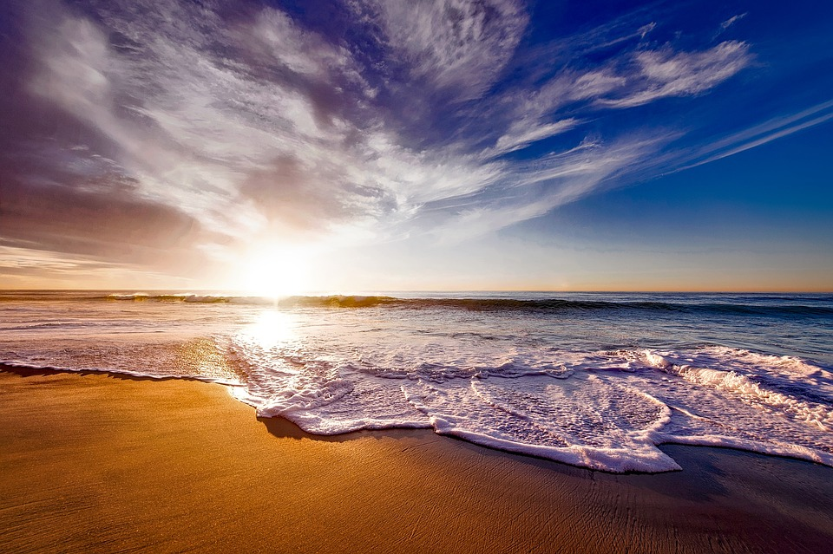
MIC Smart Beach by Bruce County
By Dr. Alex Smith
Sanjeev Kumar - Professor
Brunilda Xhaferllari – Project Manager
Rich Freeman – Faculty Menton
AI Team:
Janvi Patel
Fangji Chen
Scaria Kurian
Notes:
Image: 12019 (2016) Ocean waves crashing on shore during daytime https://pixabay.com/photos/beach-sea-sunset-sun-sunlight-1751455/

Slide 2
Project Summary
The smart beach project is a three year pilot project that will provide swimmers with up-to-date information on water conditions.
The general project agenda is to use buoy data and camera images to predict future water conditions.
There are 3 questions provided by MIC to the whole team of the project. Out of which AI team will be working on following question.
Predict the wave conditions and current visible in the camera images, as well as the number and distribution of people on the beach and in the water.

Slide 3
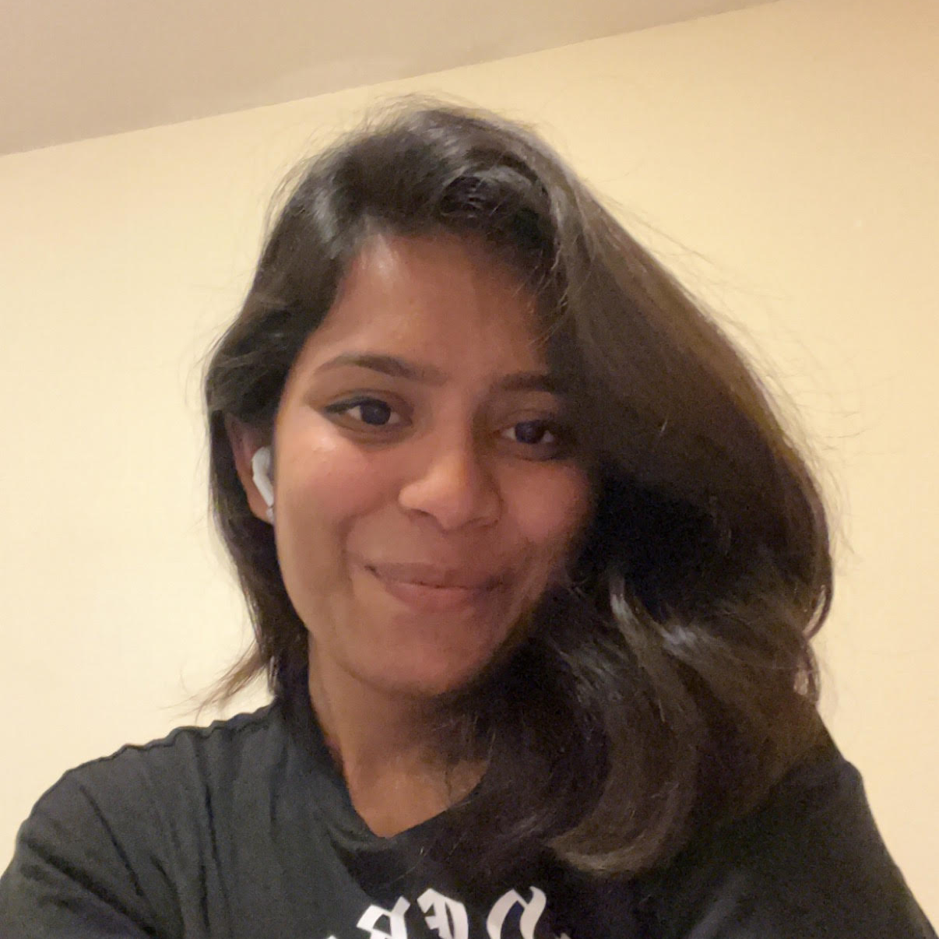
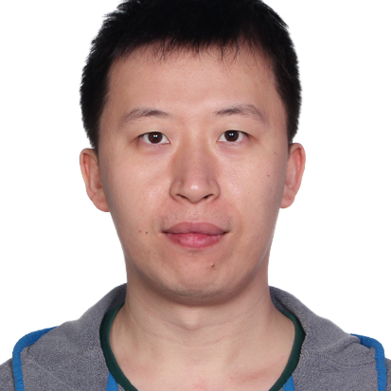

Our Team
Janvi
Patel
Fangji Chen
Scaria Kurian
Project Lead / Communicator
Developer
Analyst

Slide 4

Who we are
I have a Bachelor of Computer Science degree from GTU. Prior to the Big Data Analysis program at Georgian College, I was a software developer. In terms of skills, I have high communication and organization with intermediate level experience in Python, Power BI, Machine Learning, and Deep Learning. I look forward to this project and our future weeks together.
I have a bachelor's degree in electronic information engineering and have 10 years of working experience in software engineering, data mining, and machine learning after graduating. I'm glad to work on this project and move forward with the group.
I earned my Ph.D. in the health science field in 2018 in Taiwan, with a solid quantitative and qualitative methods training background, and I have some articles published in international journals (SSCI/SCI). Before studying in the BDAT program, I accumulated many years of experience helping clients make data-driven decisions. Additionally, I co-founded a non-profit in Taiwan, helping entrepreneurs make good use of data. I am adept at market research and predictive models and familiar with various tools (SPSS, Python, R, Power BI, Apache-Hive).
LinkedIn: https://ca.linkedin.com/in/yi-chen-hsiao

Slide 5
Project Work Breakdown Structure
Image Anonymizing Analyze the Results of different software Proposal of the best software with a quote to the client Validating anonymized data to check compatibility with DL algorithms
2. Receiving anonymized images Cleaning data Preparation for Image processing
3. Research the technique for Image Processing Explore options for Image processing Explore options for Deep learning Look for the different outputs all of them can give Check accuracy and decide on any 2 of each.
4. Build a process Based on the model prepare steps in a particular sequence Verify if the process can lead to an accurate result.
5. Apply the model

Slide 6
6. Compare both models and validate
7. Validate predictions
8. Validate results with client
9. Final Documentation
10. Project handover

Slide 7
Meeting Structure
Client Meeting: Every Thursday 10:00 AM.
Georgian College Internal Team meeting: Every Wednesday 7:00 AM.
Professor Meeting: Every Wednesday 5:00 PM.
Monthly Meetings: Last week of the Month.
All the meetings are pre-organized on MSteams.

Slide 8
General Budget
Role | Assigned To | Start | Finish | Work (in hours) | Budget
Team Lead | Janvi Patel | 09/01/2023 | 10/04/2023 | 104 | $5200
Developer | Dhanush Sriram | 09/01/2023 | 10/04/2023 | 104 | $5200
Analyst | Yuvraj Singh | 09/01/2023 | 10/04/2023 | 104 | $5200
Image Anonymizer | Dr.Smith | 09/01/2023 | 01.02/2023 | 5 | $500
Total |  |  |  | 317 | $16,100

Slide 9
Thank you

